Slide 1
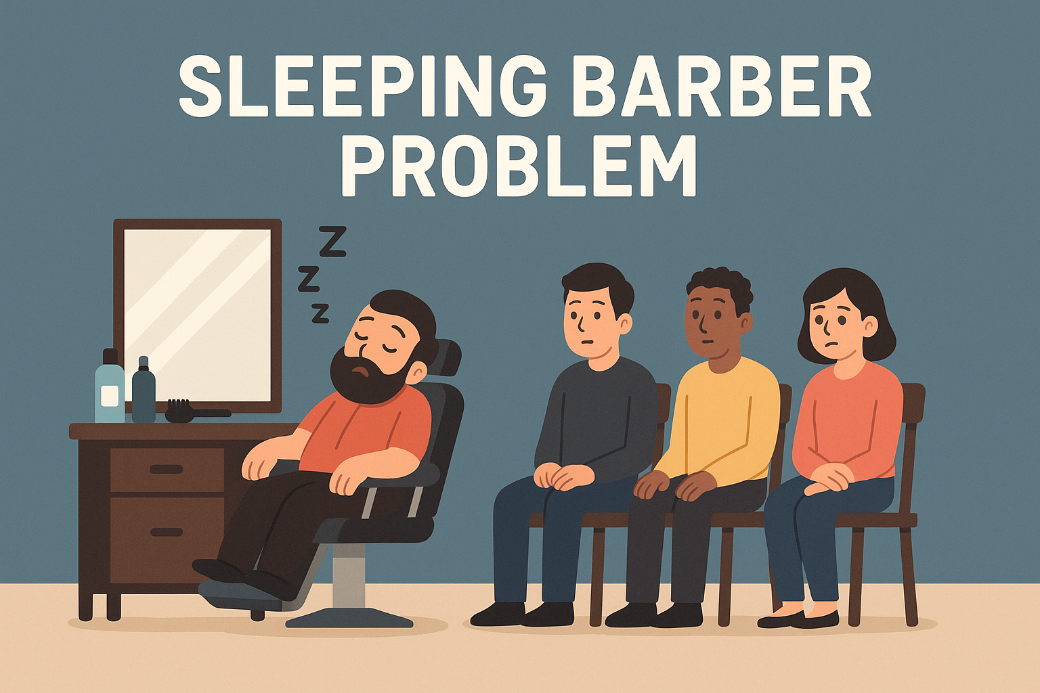
Sleeping Barber Problem
A Classical Process Synchronization Problem

Slide 2
What is Sleeping Barber Problem?
Origin: Introduced by Edsger Dijkstra
Importance in concurrency and synchronization
Real-world analogy: A barbershop with limited waiting space

Slide 3
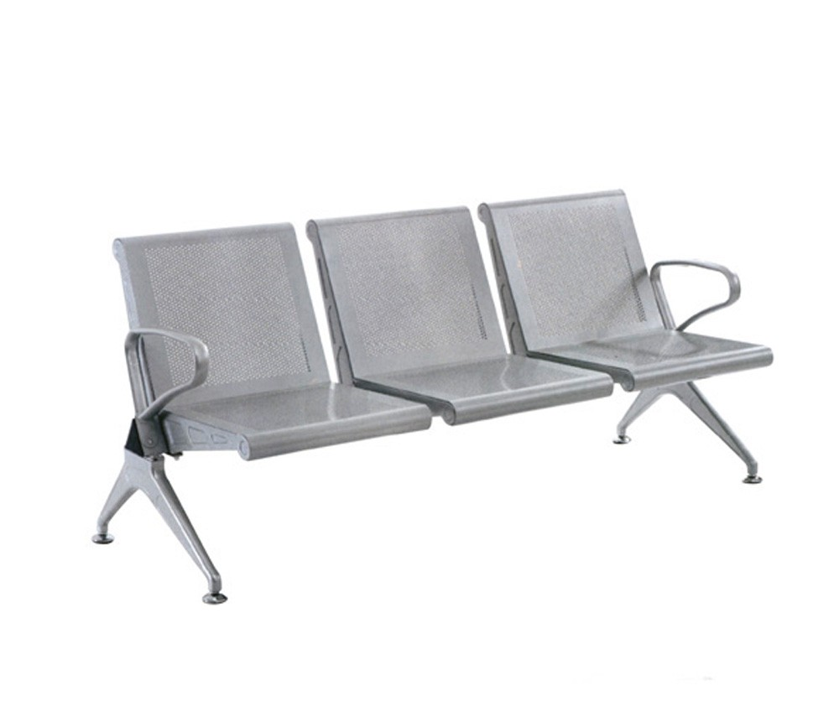

Problem Description
The first customer arrives, finds the barber asleep, and wakes him, immediately receiving a haircut.
Subsequent customers either take a vacant waiting chair or leave if all chairs are occupied.
The barber continuously cycles: sleeping when no customers are present, and cutting hair when customers are waiting.
This ensures smooth operation, preventing race conditions, deadlocks, and ensuring fair service order.

Slide 4

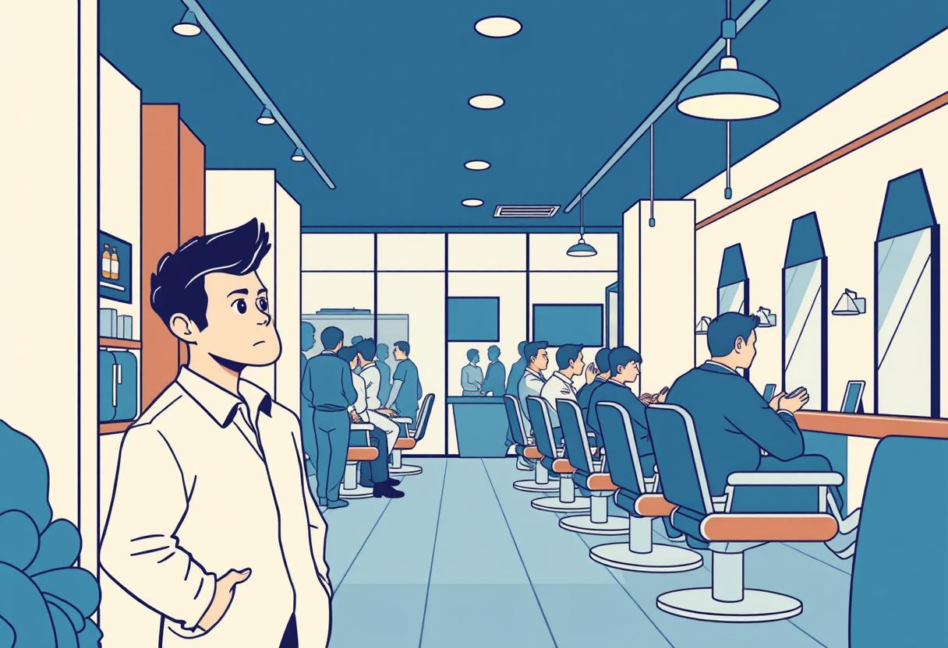
Seat Available
No seat
If a comfortable seat is open, the customer confidently settles in, ready for their turn. This is the ideal scenario for a smooth process.
If all chairs are occupied, the customer faces the classic barber dilemma: wait patiently for an opening or decide to leave

Slide 5
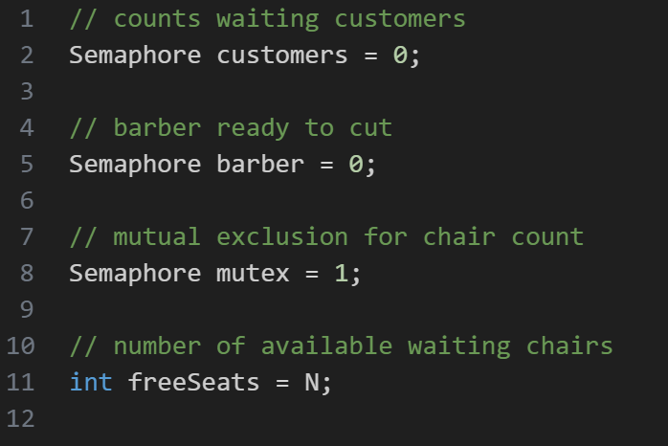
Objectives / What Needs to be Solved
Algorithm
🔐 Shared Variables:
Synchronize barber and customer threads
Avoid Race conditions, deadlocks, lost wakeups
Ensure fairness: Serve customer in order

Slide 6
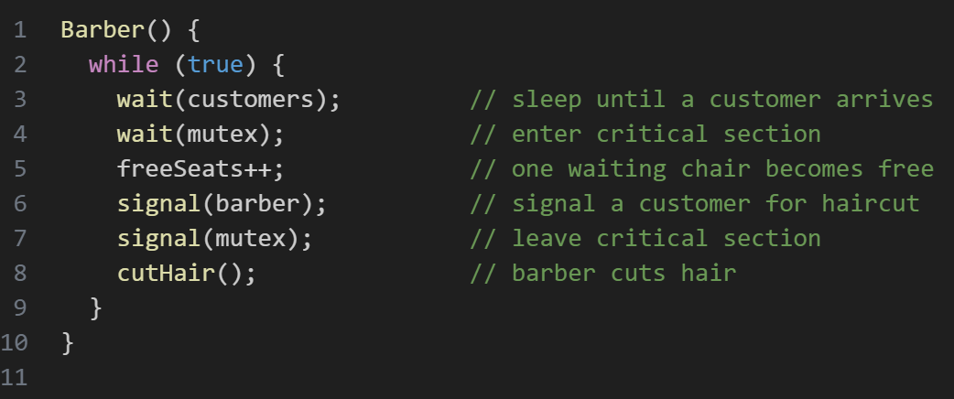
👨‍🦰 Barber Process (Thread):
Algorithm
🔐 Shared Variables:

Slide 7
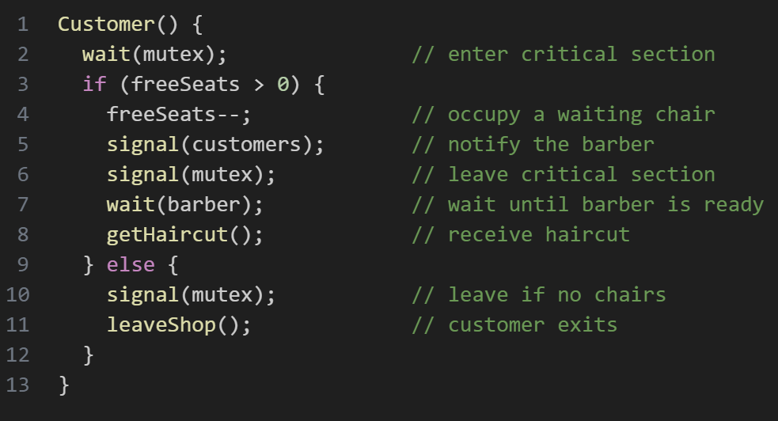
🔐 Shared Variables:
🧍‍♂️ Customer Process (Thread):
Algorithm
👨‍🦰 Barber Process (Thread):

Slide 8
🔐 Shared Variables:
👨‍🦰 Barber Process (Thread):
Algorithm
🧍‍♂️ Customer Process (Thread):

Slide 9



Conclusion: Why the Sleeping Barber Matters
Fundamental Concepts
Illustrates core synchronization challenges in concurrent programming.
Ensuring Safety
Semaphores and mutexes prevent race conditions and starvation.
Practical Foundation
Provides a clear model for designing robust IPC systems in complex software.

